Slide 1
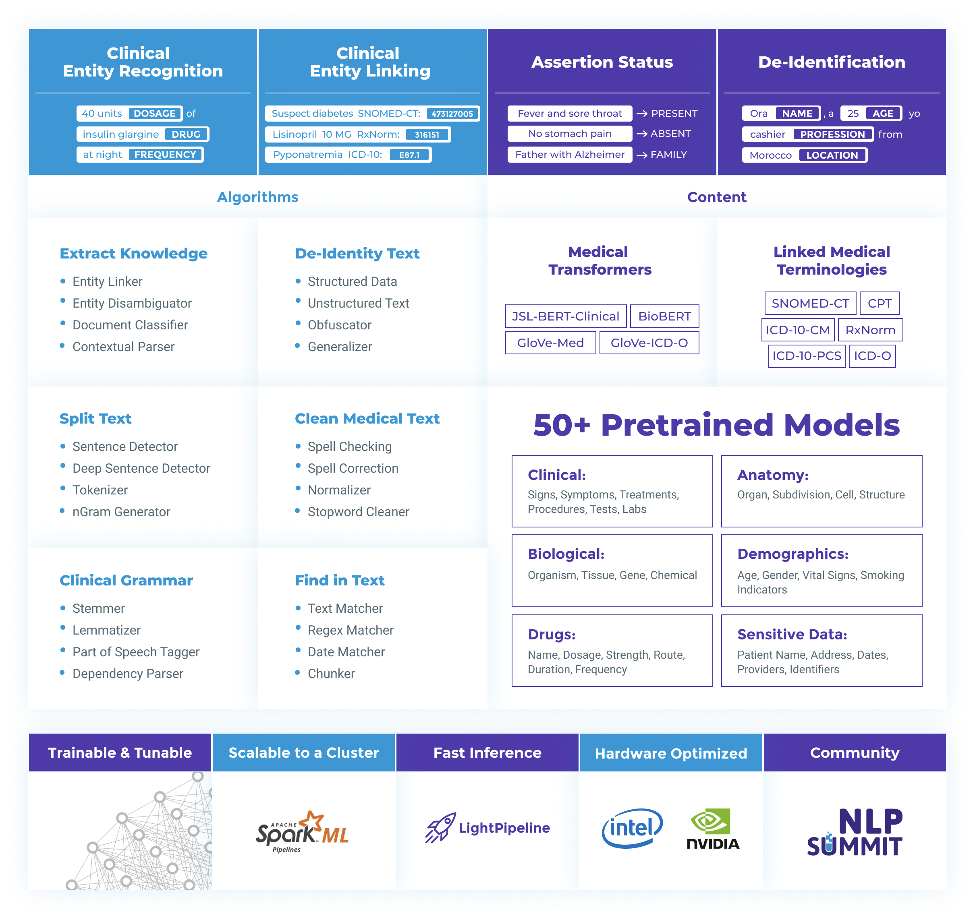
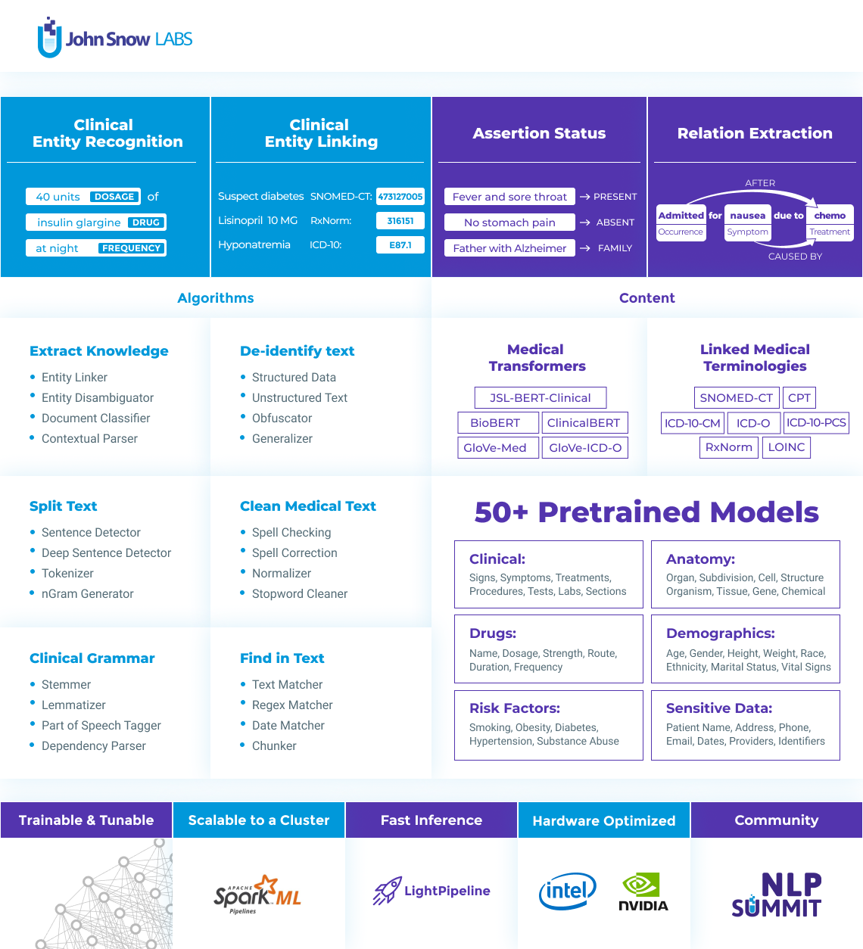
NER in Healthcare

Slide 2
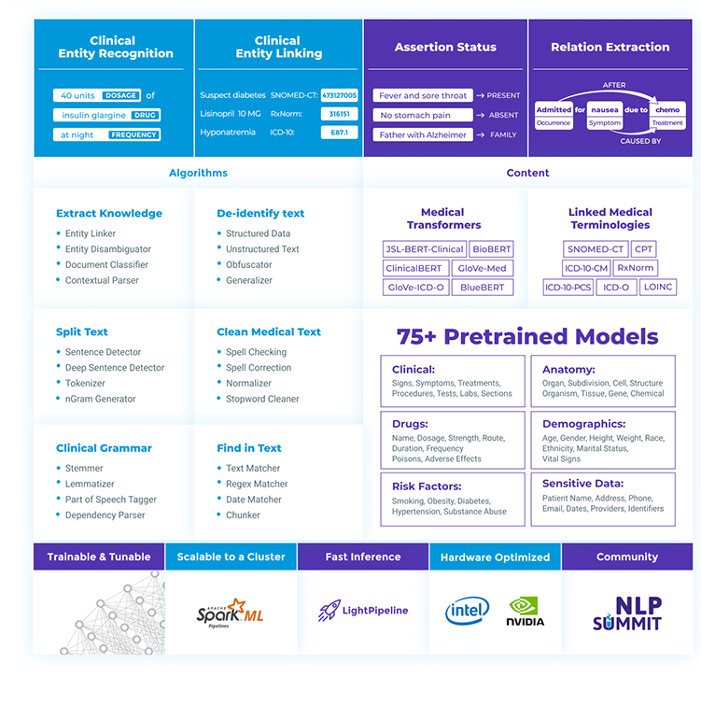
Clinical Named Entity Recognition (NER)
Extract structured data from free text
Automate record keeping & abstraction process
Feeding downstream tasks
Features for ML models

Slide 3

NLP Feature | Spark NLP | spaCy | NLTK | CoreNLP | Hugging Face
Tokenization | Yes | Yes | Yes | Yes | Yes
Sentence segmentation | Yes | Yes | Yes | Yes | No
Steeming | Yes | Yes | Yes | Yes | No
Lemmatization | Yes | Yes | Yes | Yes | No
POS tagging | Yes | Yes | Yes | Yes | No
Entity recognition | Yes | Yes | Yes | Yes | Yes
Dep parser | Yes | Yes | Yes | Yes | No
Text matcher | Yes | Yes | No | No | No
Date matcher | Yes | No | No | No | No
Sentiment detector | Yes | No | Yes | Yes | Yes
Text classification | Yes | Yes | Yes | No | Yes
Spell checker | Yes | No | No | No | No
Language detector | Yes | No | No | No | No
Keyword extraction | Yes | No | No | No | No
Pretrained models | Yes | Yes | Yes | Yes | Yes
Trainable models | Yes | Yes | Yes | Yes | Yes
Spark NLP
73 total releases
Release every two weeks for the past 3 years
A single unified library for all your NLP/NLU need
Active community on Slack and GitHub

